Slide 1
Working with Dataflows
Working with Dataflows

Slide 2
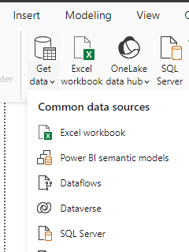
Working with Dataflows
Note : This lab requires a Power BI Services account with administrator privileges.
Open Power BI Desktop , select Dataflows .

Slide 3
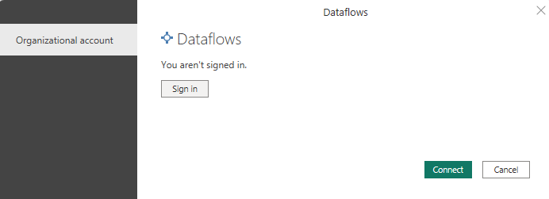
Working with Dataflows
Click Connect .​
Note : We need to log in with a Power BI Services account.

Slide 4
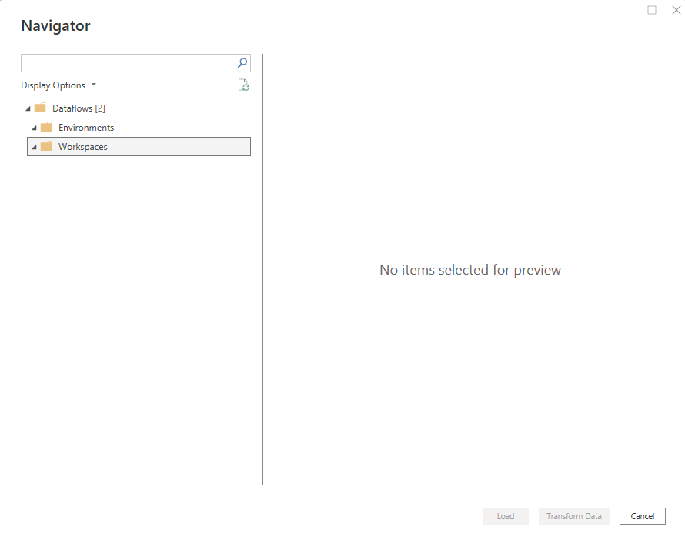
Working with Dataflows
If this is the first opening, no Dataflow is defined yet.

Slide 5

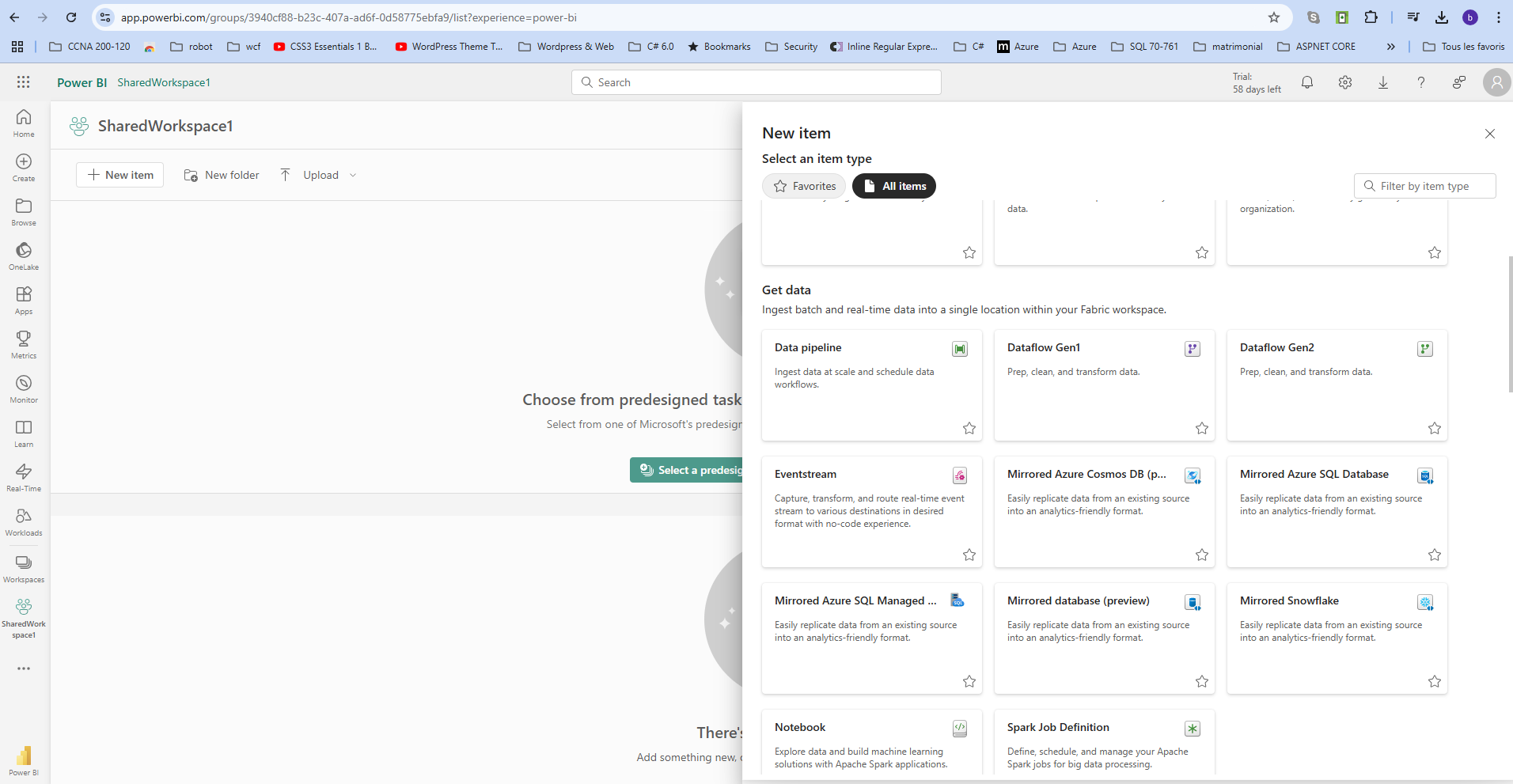
Working with Dataflows
Power BI Services session , navigate to the shared workspace, click ... , and then choose DataFlow .

Slide 6
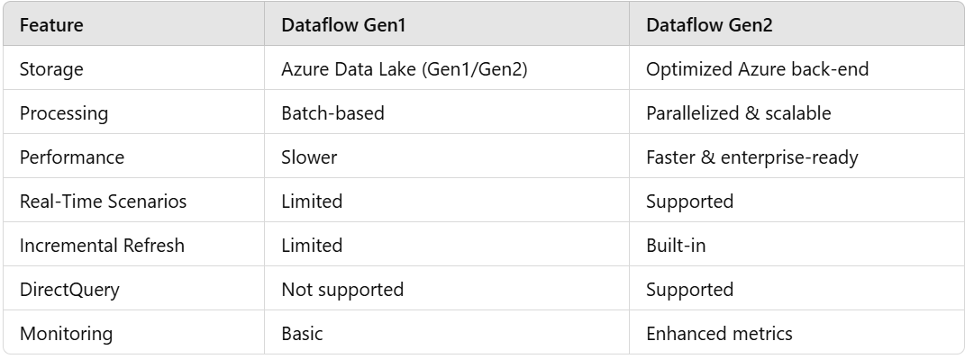
Working with Dataflows
Here are some key differences between the two versions of DataFlow .

Slide 7
Working with Dataflows
Power BI Services session , navigate to the shared workspace, click ... , and then choose DataFlow .

Slide 8
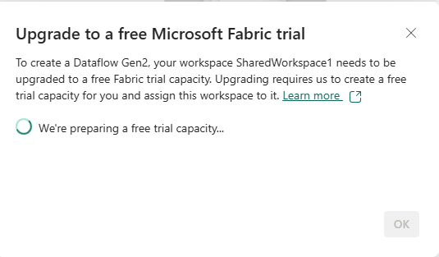
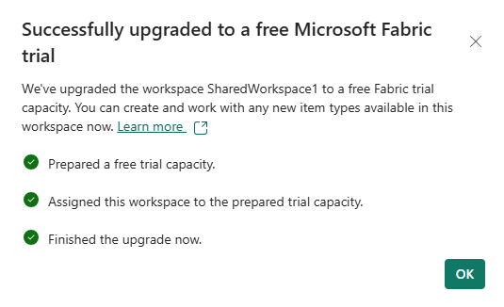
Working with Dataflows
Power BI Services session , navigate to the shared workspace, click ... , and then choose DataFlow .

Slide 9
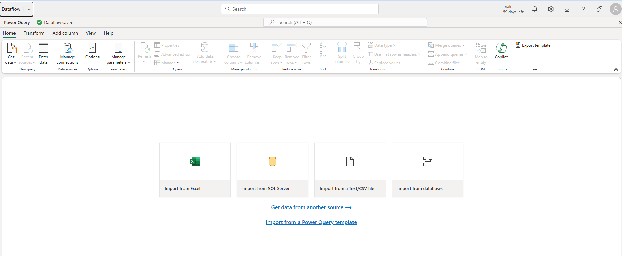
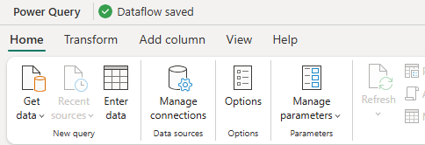
Working with Dataflows
Note that the environment is similar to Power BI Desktop .

Slide 10
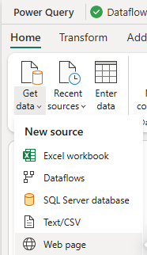
Working with Dataflows
Select Get Data , then Web Page .

Slide 11
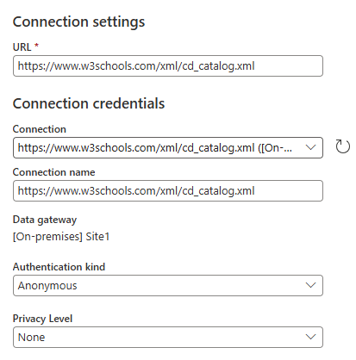
Working with Dataflows
Then configure the data source
https://www.w3schools.com/xml/cd_catalog.xml

Slide 12
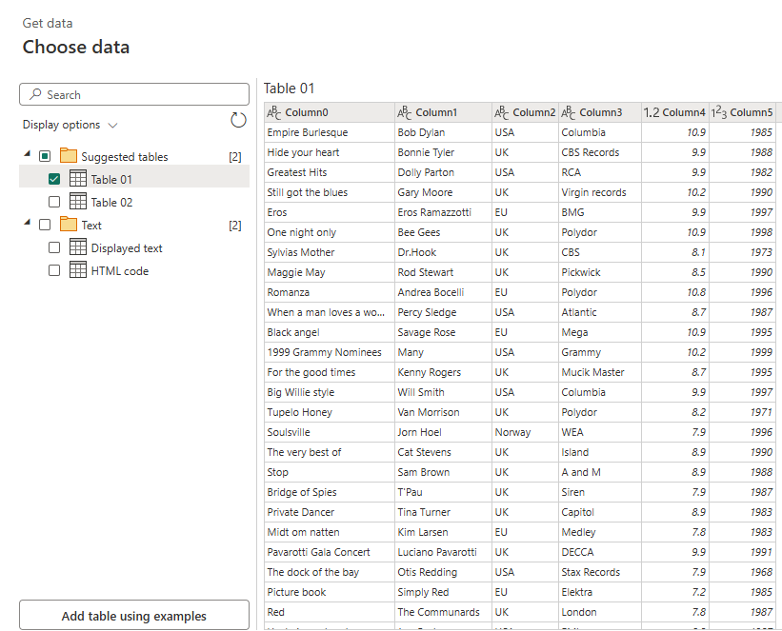
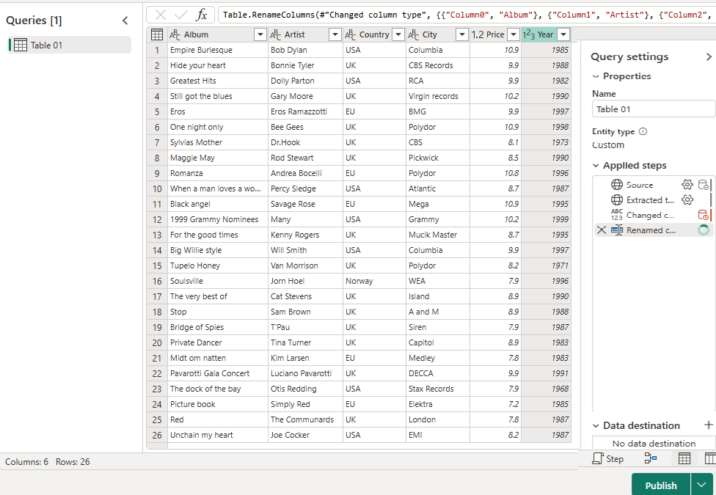
Working with Dataflows
Select Table 01 , this will be our data source, then click Create .
Edit the column headers to give them more meaningful names, then click Publish .

Slide 13
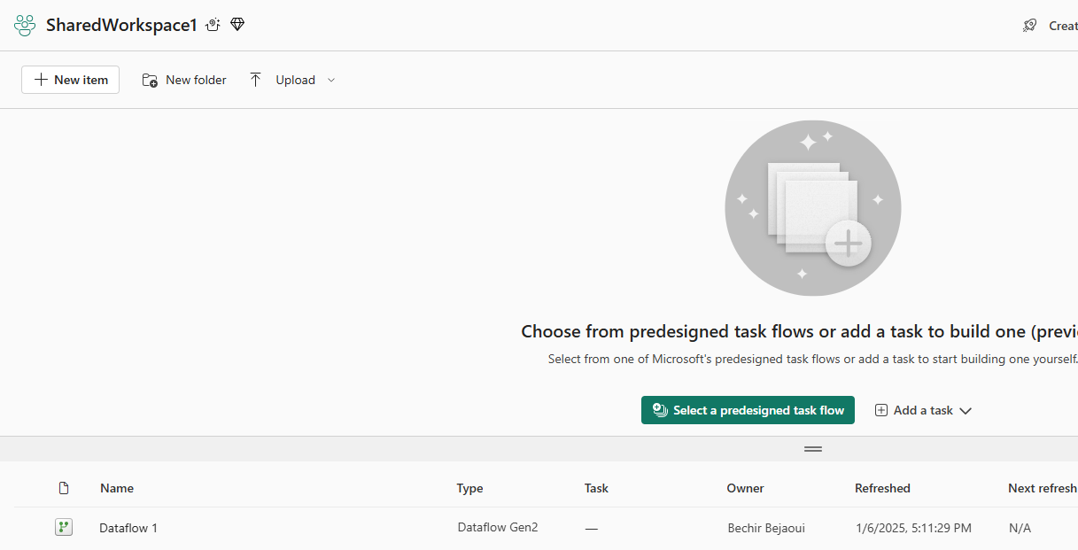
Working with Dataflows
We should note the presence of the newly created DataFlow .

Slide 14
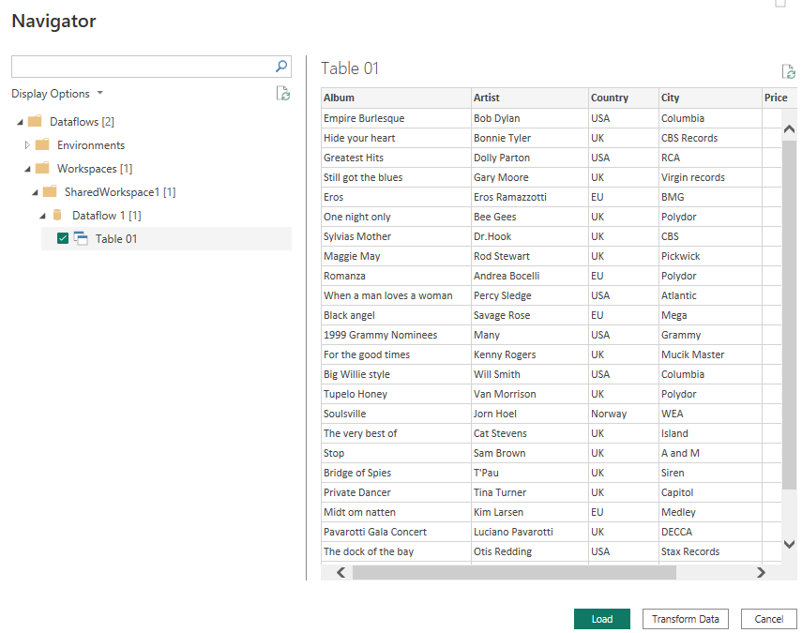
Working with Dataflows
Now notice the presence of the DataFlow in Power BI Desktop . The data is ready to be used.

Slide 15
THANKS
THANKS

